Slide 1
INTRODUCTION TO SOFTWARE ENGINEERING
LUVRENT
NHÓM 4

Slide 2

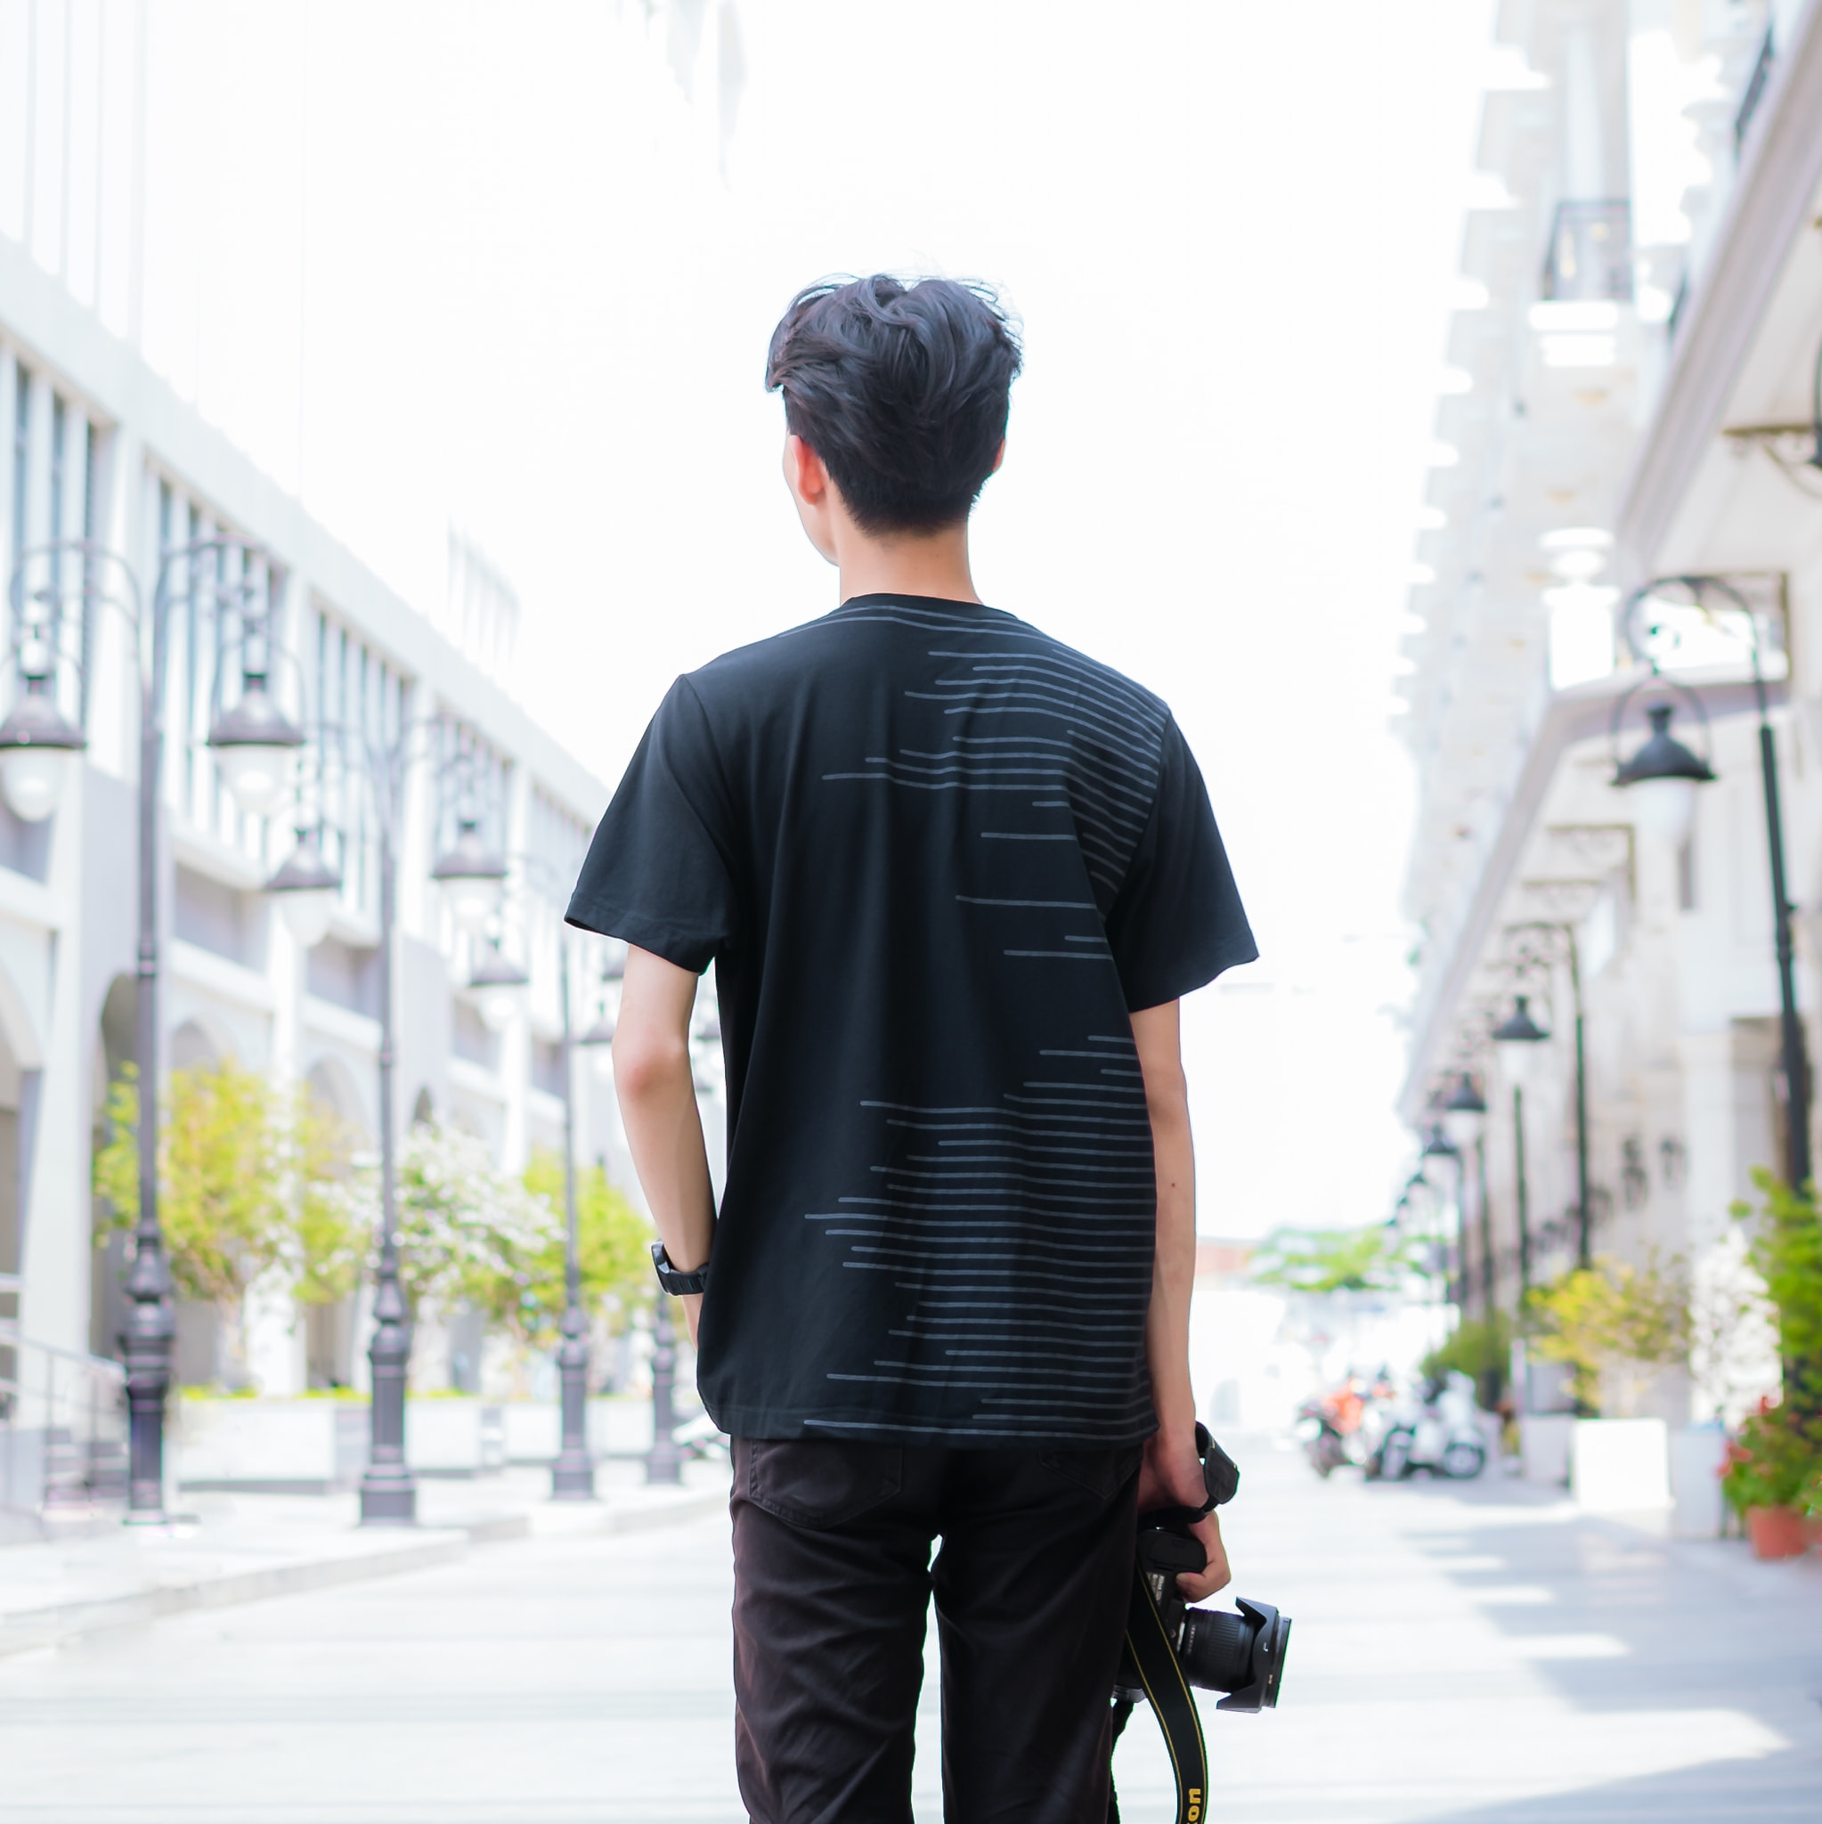


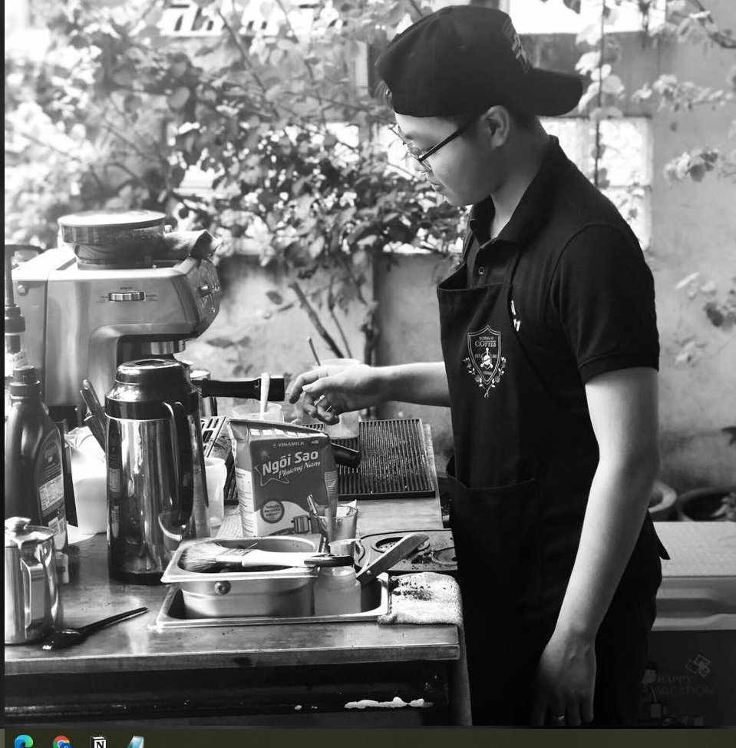
MEMBER
LÊ ĐẮC HOÀNG PHÚC
NGUYỄN VIỆT BÁCH
Facebook:
https://www.facebook.com/ledachoang.phuc
Facebook:
https://www.facebook.com/ngvbach2000
LÊ NGUYỄN GIA HUY
Facebook:
https://www.facebook.com/profile.php?id=100008267718410
NGUYỄN SĨ TRỌNG
TRẦN LÊ MINH ĐỨC
Facebook:
https://www.facebook.com/trongiwa79/
Facebook:
https://www.facebook.com/profile.php?id=100004817761336

Slide 3
AGENDA
01
BACKGROUND
02
CONCEPT (WHAT IS IT?)
03
DETAILS OF PRODUCT
04
USECASE DIAGRAM
05
CONCLUSION & FUTURE PLAN

Slide 4
01
BACKGROUND

Slide 5
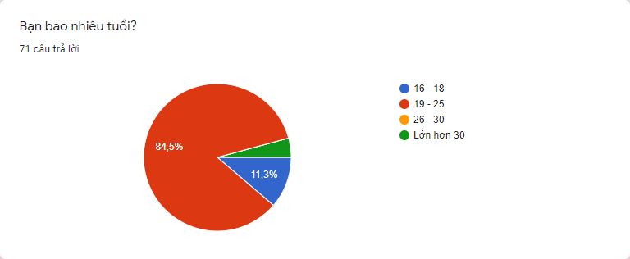
01
BACKGROUND

Slide 6
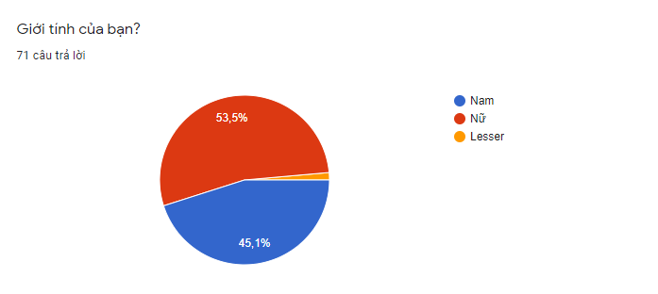
01
BACKGROUND

Slide 7
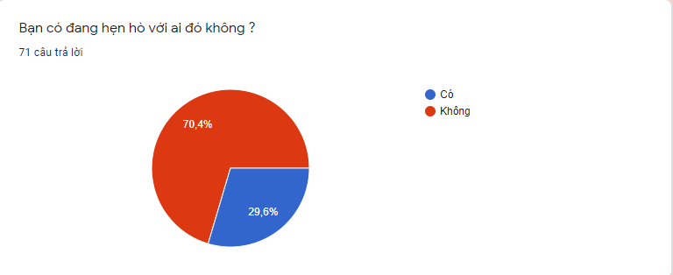
01
BACKGROUND

Slide 8
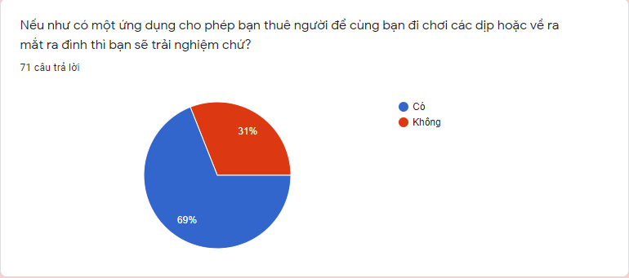
01
BACKGROUND

Slide 9
01
BACKGROUND

Slide 10
02
CONCEPT (WHAT IS IT?)

Slide 11
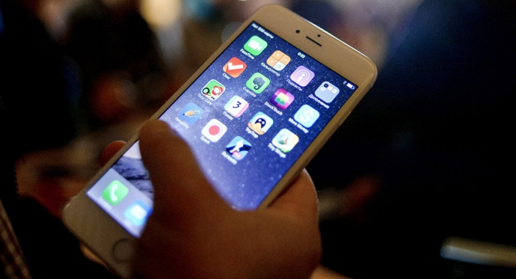
02
CONCEPT (WHAT IS IT?)
This is an app help you rent a lover

Slide 12

02
CONCEPT (WHAT IS IT?)
SIGNIFICATION
“LONELY”

Slide 13
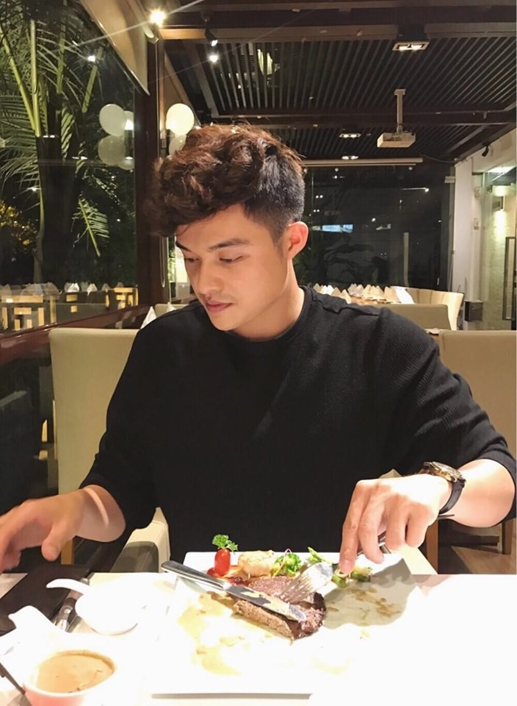
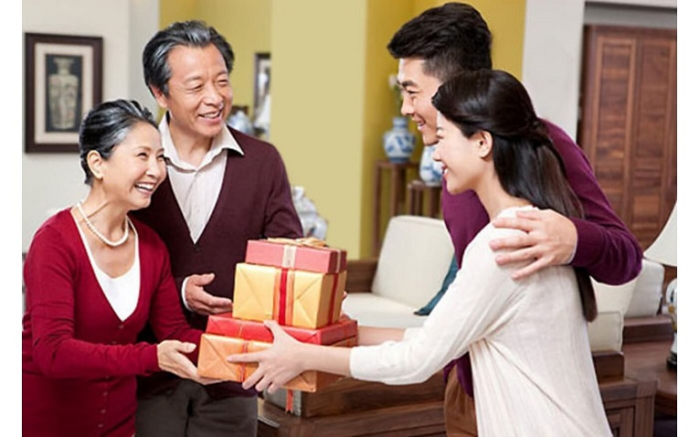
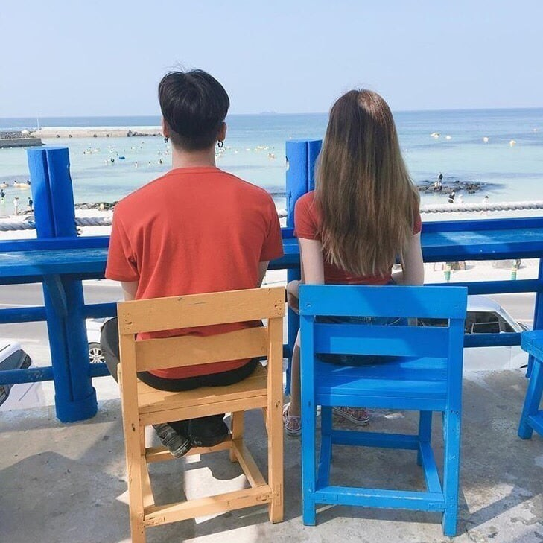
02
CONCEPT (WHAT IS IT?)
PURPOSE
Having dinner together
Meeting family
Traveling

Slide 14

02
CONCEPT (WHAT IS IT?)
USERS
All user objects
A person who can’t find real love
A person who are shy

Slide 15

02
CONCEPT (WHAT IS IT?)
MOST OUTSTANDING FEATURES
A list with pictures, basic information provided
A map provides location of people close to you
Sending message

Slide 16
03
DETAILS OF PRODUCT

Slide 17
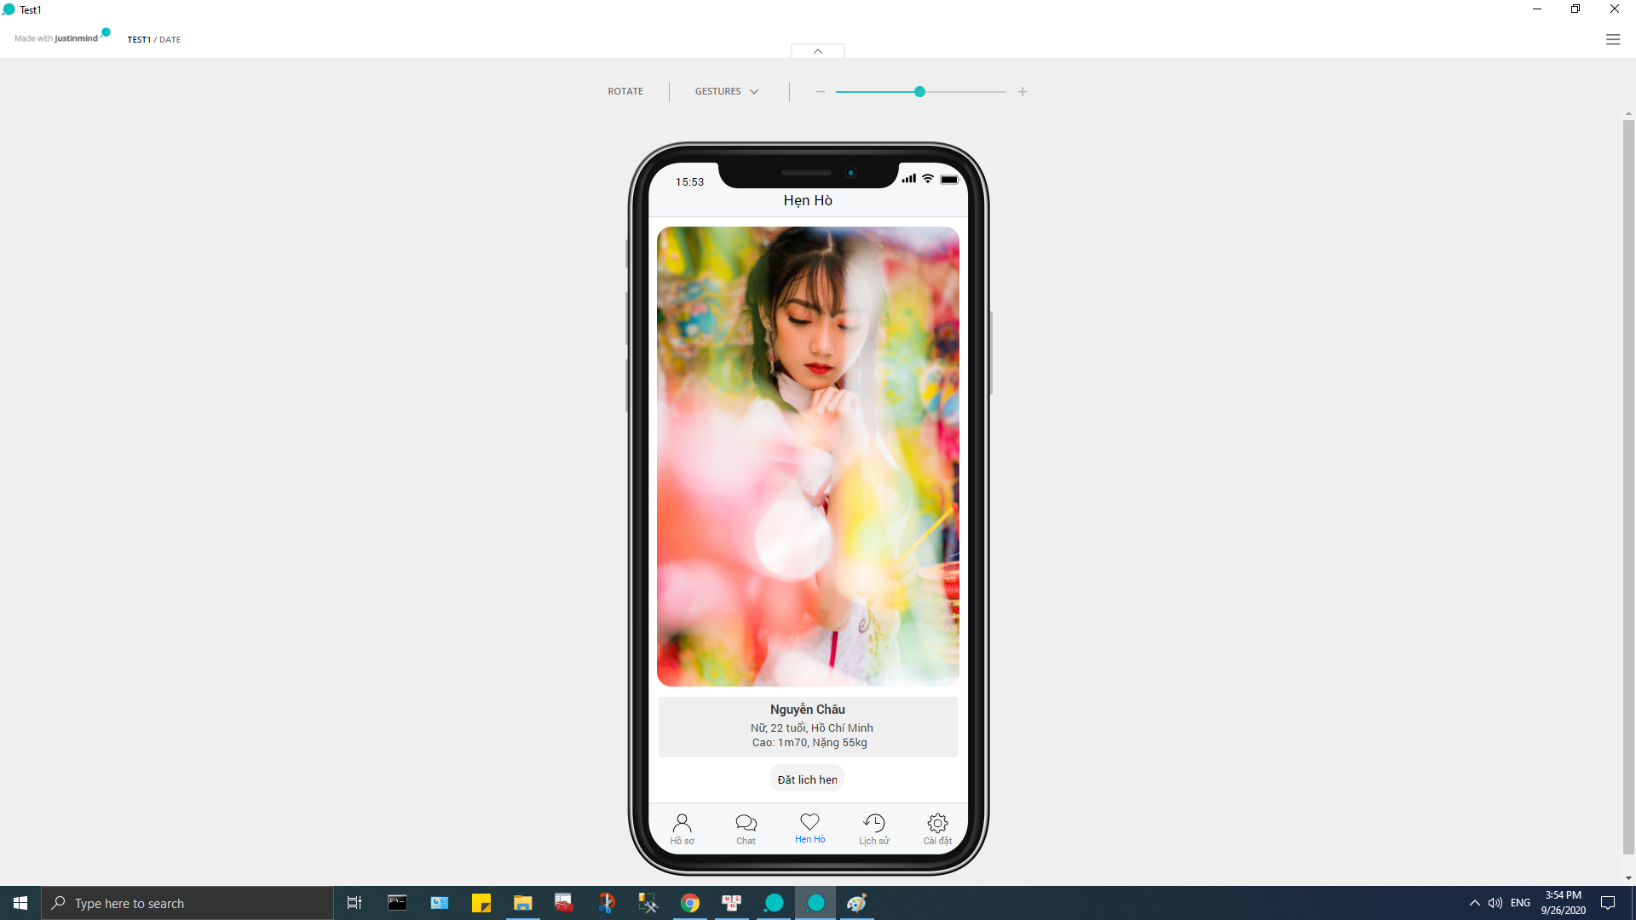
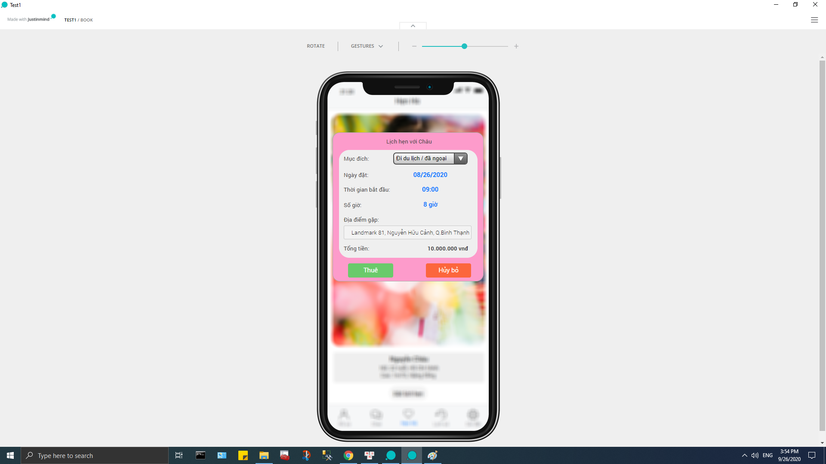
03
DETAILS OF PRODUCT
DATE

Slide 18
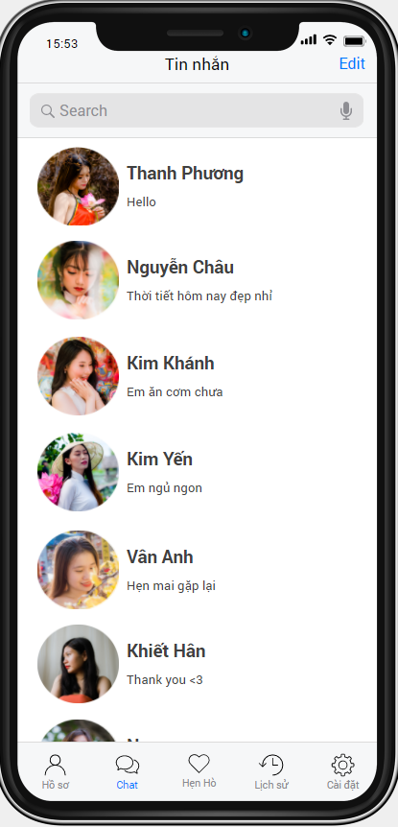
03
DETAILS OF PRODUCT
CHAT

Slide 19
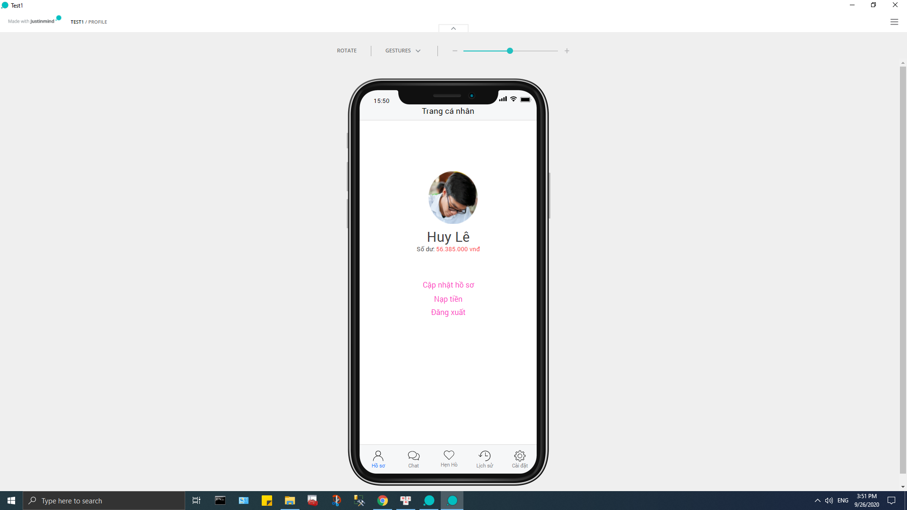
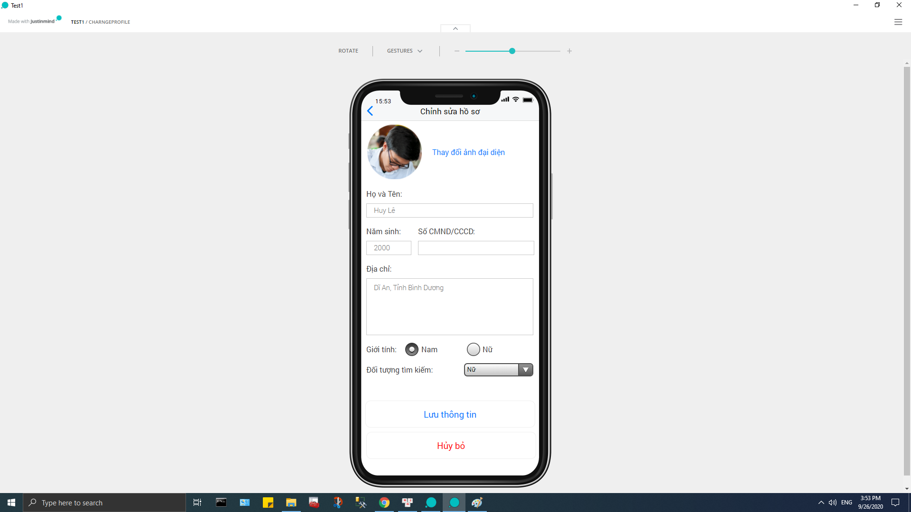
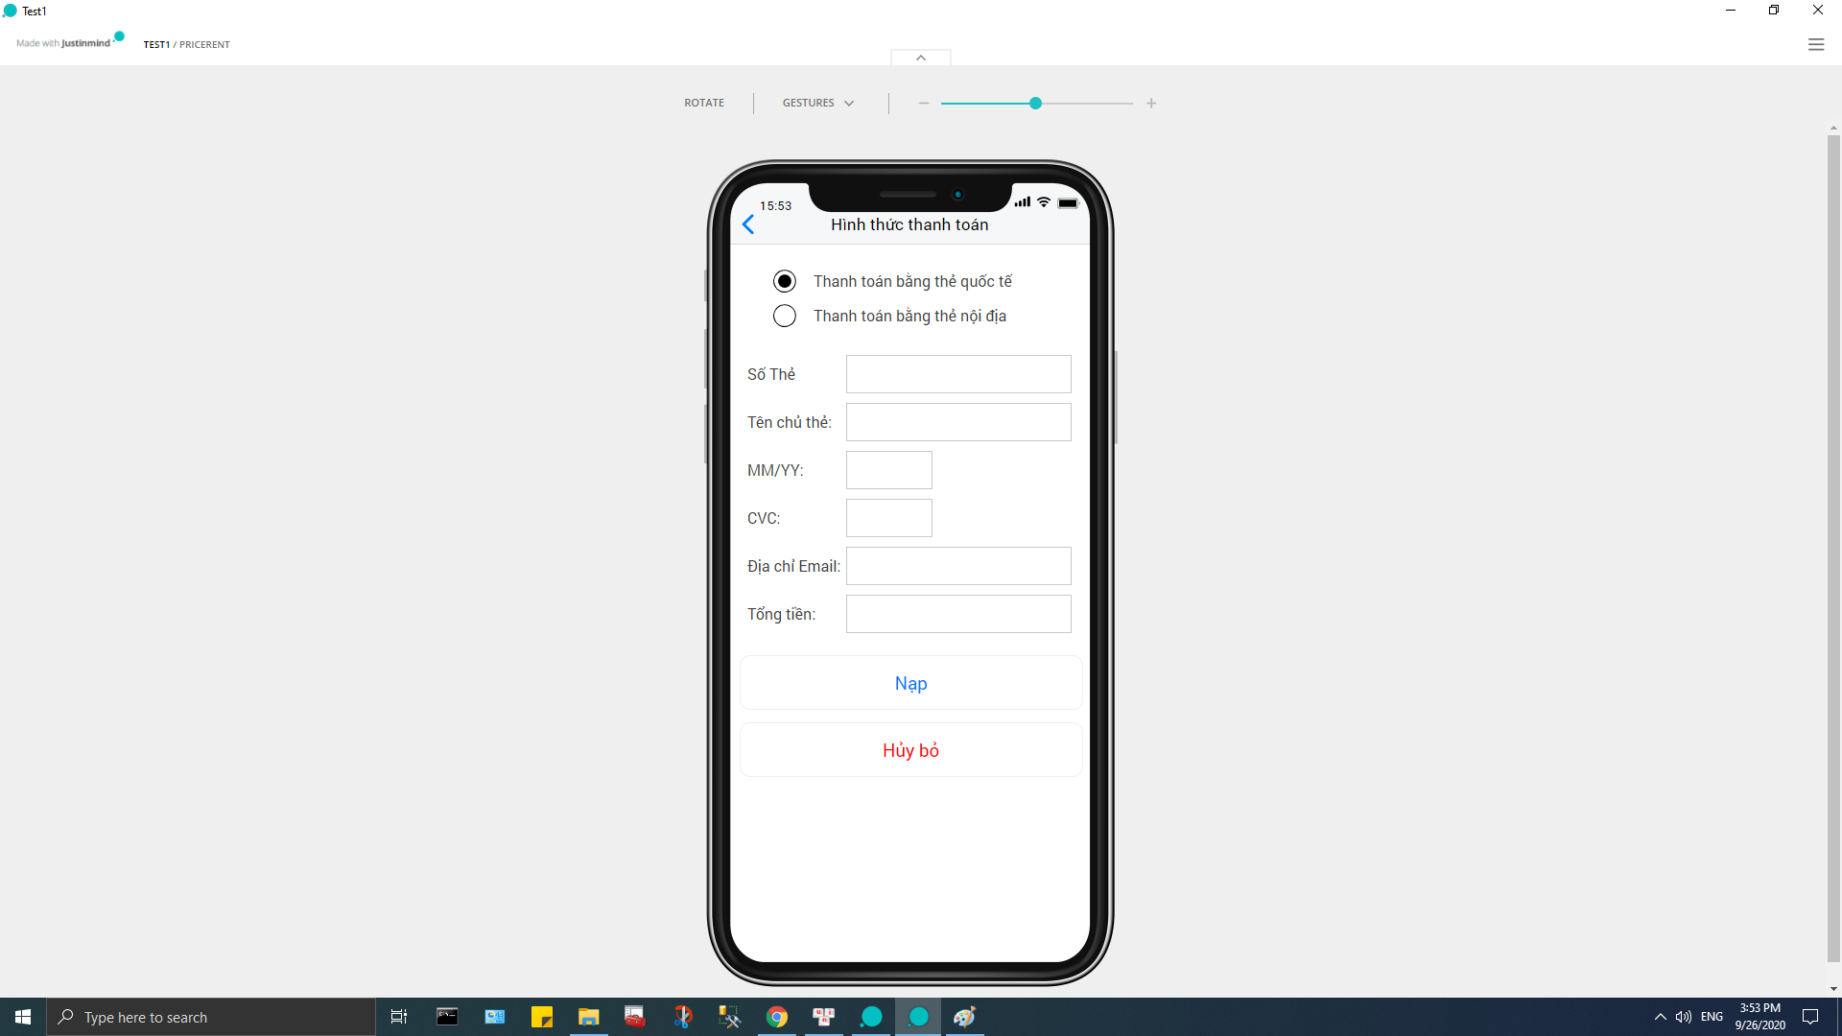
03
DETAILS OF PRODUCT
PROFILE

Slide 20
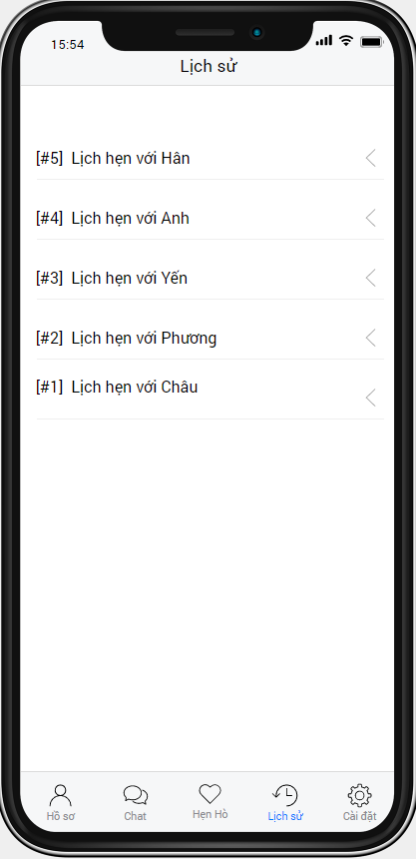
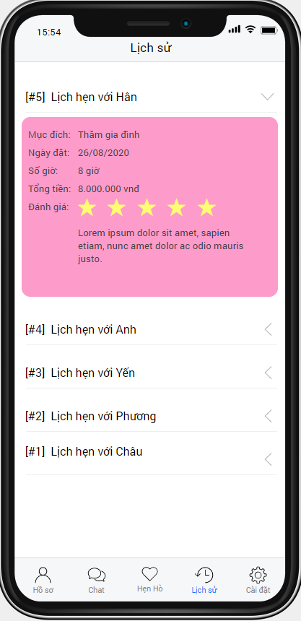
03
DETAILS OF PRODUCT
HISTORY

Slide 21
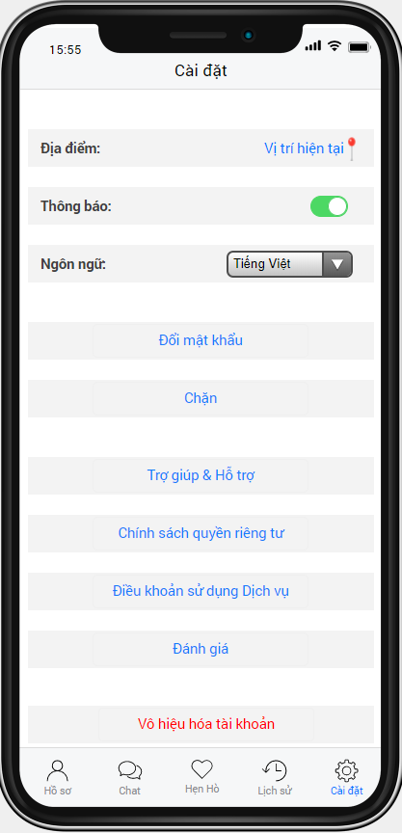
03
DETAILS OF PRODUCT
SETTING

Slide 22
04
USECASE DIAGRAM

Slide 23
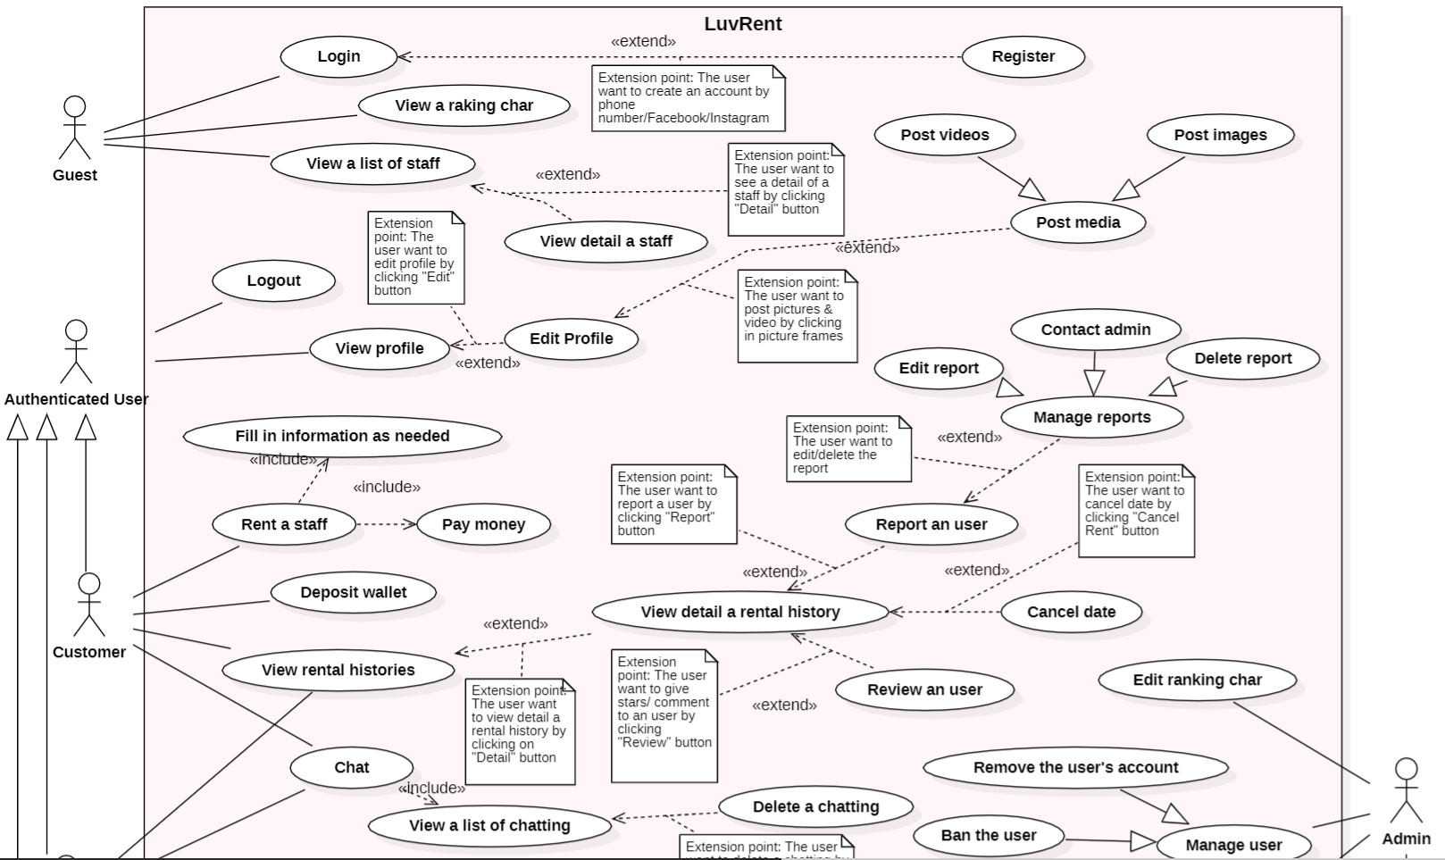
04
USECASE DIAGRAM

Slide 24
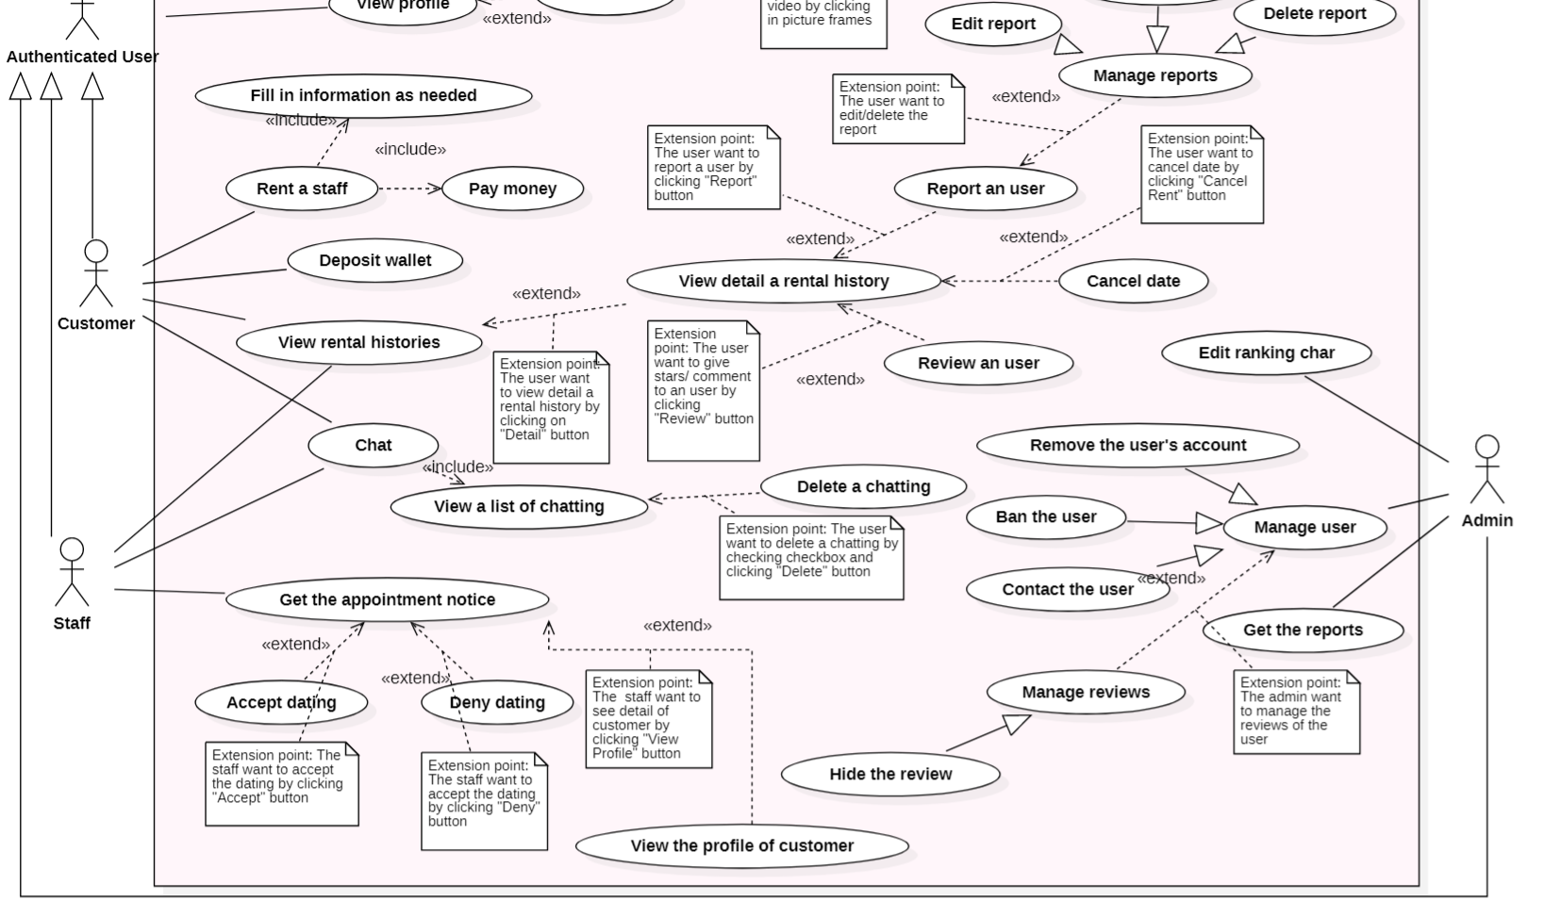
04
USECASE DIAGRAM

Slide 25
05
CONCLUSION & FUTUTRE PLAN

Slide 26
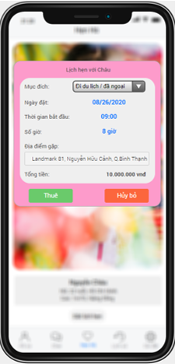
05
CONCLUSION & FUTURE PLAN
Survey results
The interface of the app
The main function of the app: chat, create appointment, payment.
Future Function:
Emotional counseling
Blog

Slide 27
REFERENCES
Dịch vụ hẹn hò, thuê người yêu: Người Yêu Đẹp - https://nguoiyeudep.com
Ứng dụng tán gẫu, tìm người yêu: Tinder - https://tinder.com

Slide 28

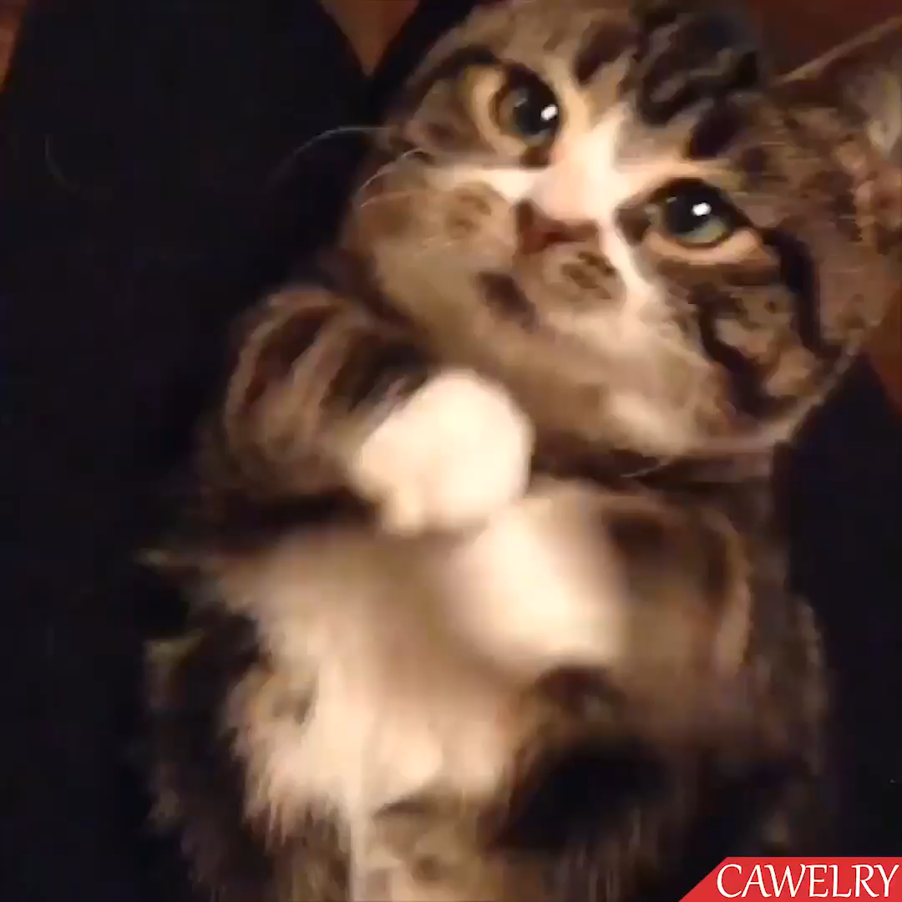
THANK YOU

